Slide 1




St. Louis Crime
A Study of Trends and Predictive Analytics
Created By: Denise Dodd
Notes:
Hello, my name is Denise Dodd. This will be a presentation reviewing the 10 most anticipated questions pertaining the trends of crime in St. Louis and a prediction of future crime volume. With the information gained in this study, the St. Louis Police Department will be better able to allocate personnel and resources, identify the major types of crime in the city, and predict what the future of St. Louis crime will look like if all other factors remain constant.

Slide 2
Data
This study will utilize data provided by the St. Louis Metropolitan Police Department detailing crimes reported in the year 2020.
Important variables included in this dataset include:
Month Reported
Date Occurred
Created Variable: TimeLag
District
Crime
Created Variable: Category
4
5
2
1
3
Notes:
Month Reported – This data set details crime reported in 2020.
Date Occurred – There can be a delay between when a crime occurs and when it is reported. A “TimeLag” variable will be created detailing this delay.
District – This details the 7 districts that comprise the city of St. Louis.
Crime – This column has a UCR (uniformed crime) number which details the over arching category of crime such as arson, fraud, etc.
Category – An additional “Category” col will be created based on the Crime col.

Slide 3
Data
Important Considerations Regarding Assumptions and Limitations
-2020 was a unique year for crime nationwide
-Not all crimes that occurred in 2020 are in the dataset
-Crime volume vs crime rate
4
5
2
1
3
Notes:
Another important note regarding this dataset is that nationwide, 2020 was an outlier in the volume of crime due to the covid pandemic and low recruitment rates in law enforcement.
As mentioned above, crime is not always reported the day that it occurs. There can be a significant lag time between a crime occurring and when it is reported as we will review in tis presentation. Therefore, we can assume that while this dataset details all crimes reported in 2020, it does not detail all crimes that occurred in 2020.
Population data is not available. Therefore it is important that this study is framed in the context of crime volume, not crime rate.

Slide 4
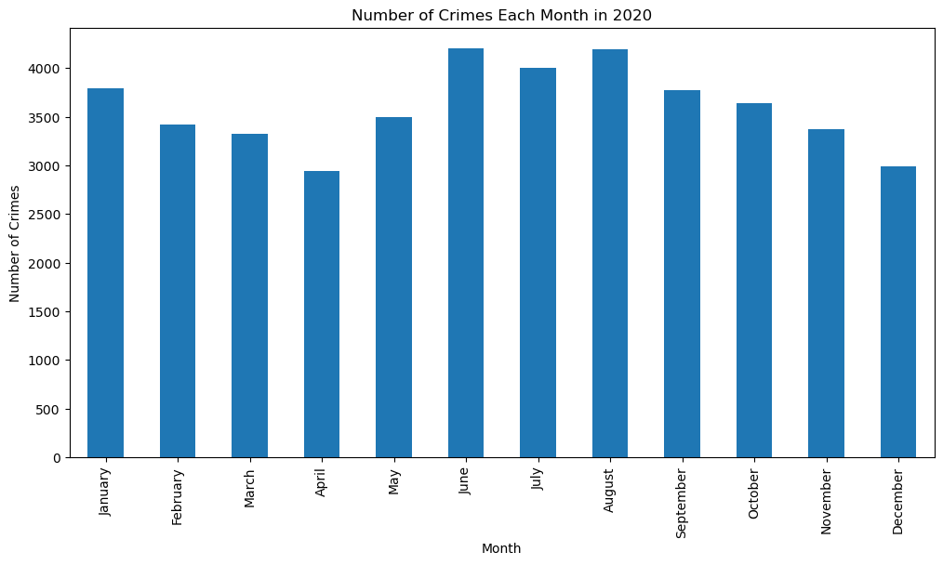
When Crime Occurs
Question #1: Are there any trends in the time of year that crime occurs?
4
5
2
1
3
Notes:
First, I will review various trends in WHEN crime occurs. To begin this section, I will review the time of year that crime occurs.
This is a bar graph showing the number of crimes that occurred each month in St. Louis for the year 2020. Overall, the volume of crime tends to dip in the spring, rise in the summer, and begin to decrease again towards the end of the year.

Slide 5
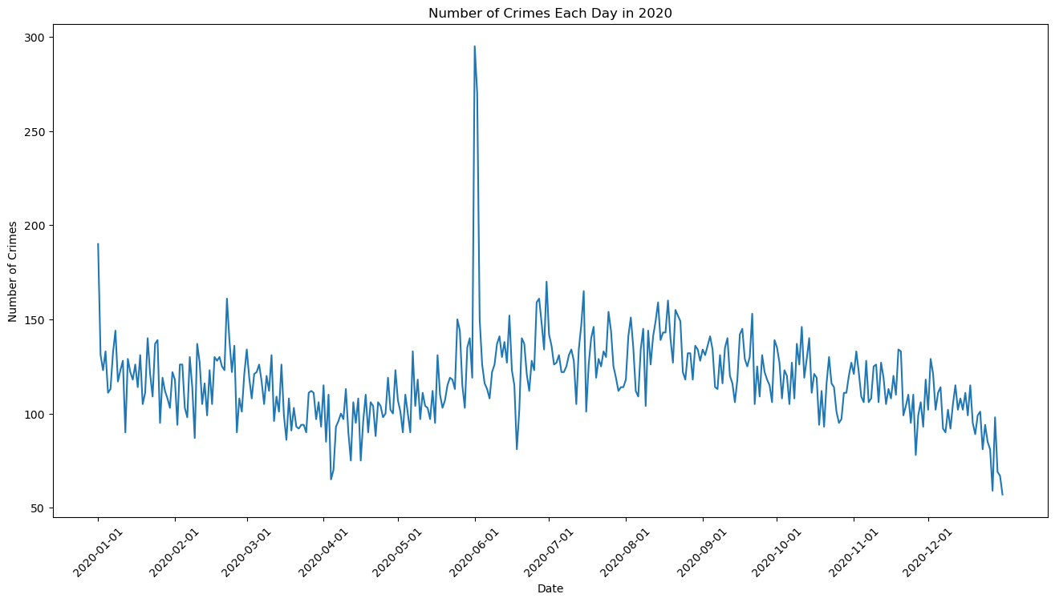
When Crime Occurs
Question #1: Are there any trends in the time of year that crime occurs?
4
5
2
1
3
Notes:
This line graph offers a different perspective on the yearly trends in crime showing the daily volumes of crime instead of monthly. Here we can see more ebbs and flows. There is a large spike in early June that was not as noticeable on the monthly graph. This will be addressed on the next slide.

Slide 6
When Crime Occurs
Question #2: What caused the spike in crime at the beginning of June?
Date | Crime Volume
June 1, 2020 | 295
June 2, 2020 | 270
4
5
2
1
3
Date | Complaint | Number of Incidents
June 1, 2020 | 20-023291 | 43
June 1, 2020 | 20-024284 | 41
June 2, 2020 | 20-023353 | 24
Notes:
After isolating the days in the dataset with a high volume of crime, I found two days in June that had over 250 incidents in crime.
I then researched the complaints on those days and found three complaints with over 20 incidents of crime recorded on one complaint. If more than one incident of crime is recorded during the same event, that will be multiple counts of crime on one complaint. For example, if during the course of a burglary there is an assault, both the burglary and the assault charges will be recorded on the same complaint. I researched these complaints and learned that all of the incidents on the complaint were aggravated assault charges. This incidents that there were several large fights in early June resulting in the spike in crime that was revealed in the daily line graph.

Slide 7
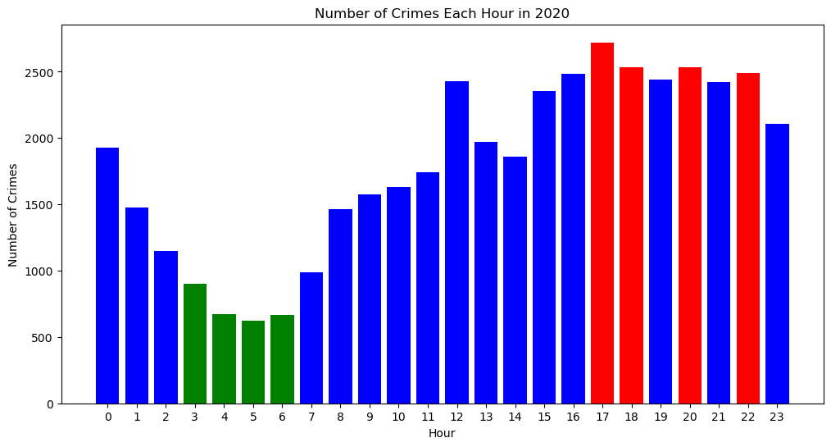
When Crime Occurs
Question #3: Are there any trends in the time of day that crime occurs?
4
5
2
1
3
Notes:
To further drill down on when crime occurs, this bar graph details the volume of crime each hour. The hours with the least amount of crime are shaded in green and the hours with the most amount of crime are shaded in red. It is apparent that the least amount of crime occurs in the early hours and the most crime occurs in the evening hours.

Slide 8
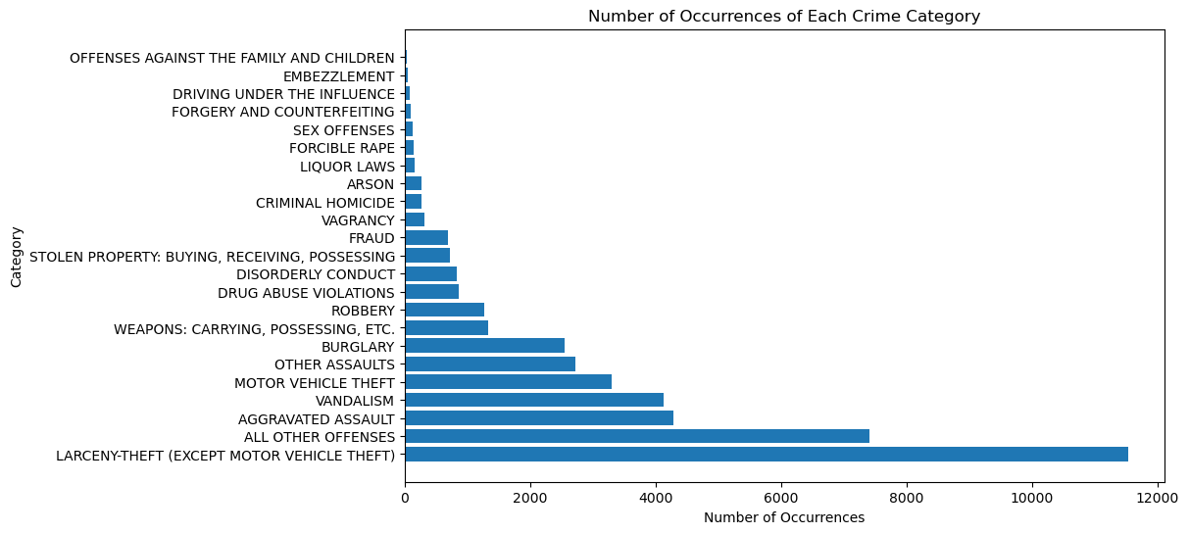
Where Crime Occurs
Question #4: Which categories of crime are most/least prevalent in St. Louis?
4
5
2
1
3
Notes:
The above horizontal bar graph shows that larceny is by far the most prevalent crime in the city followed by the catchall of “All Other Offenses.” There are many categories of crime at the top of the visualization that barely register on the graph.

Slide 9
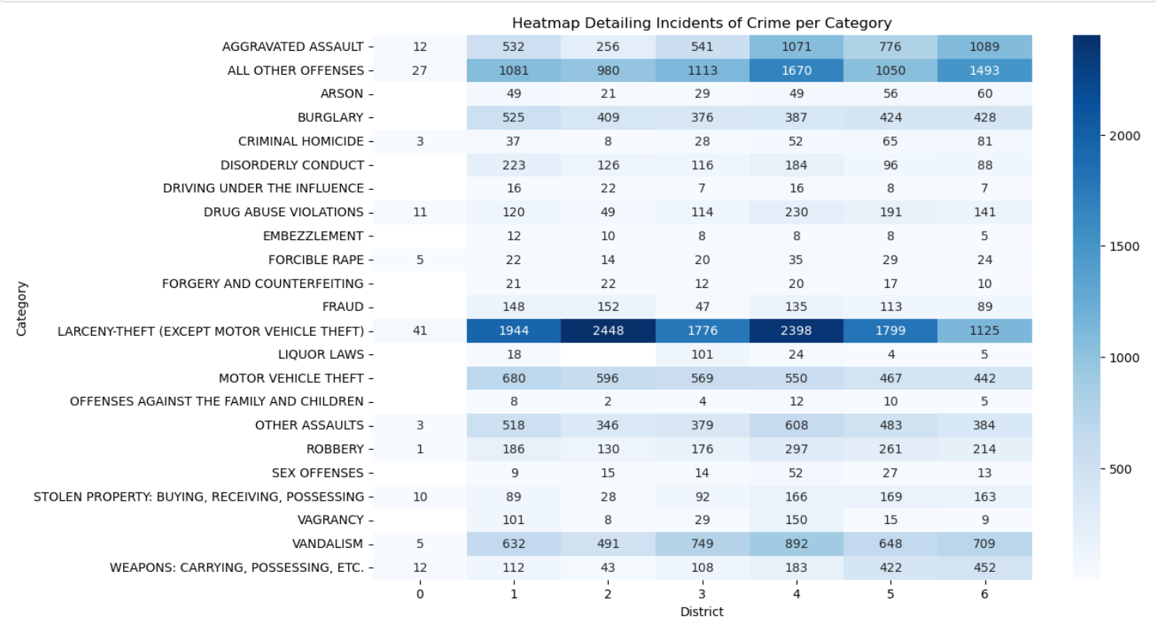
Where Crime Occurs
Question #5: How is crime distributed among the districts?
4
5
2
1
3
Notes:
Now that we understand the overview of crime in the city, let’s drill down by district. This heatmap uses a deep color of blue to indicate high volume of crimes and increasingly lighter colors of blue to represent lower volume of crime. It is quickly apparent that across almost all districts, Larceny is the category of crime with the highest volume. In District 6, Larceny is a close second behind “All Other Offenses.” The other apparent takeaway from this heatmap is that District 0 has very low volume of crime. It would be interesting to incorporate a population variable here to compare the crime rate in District 0 to the crime volume in District 0.

Slide 10
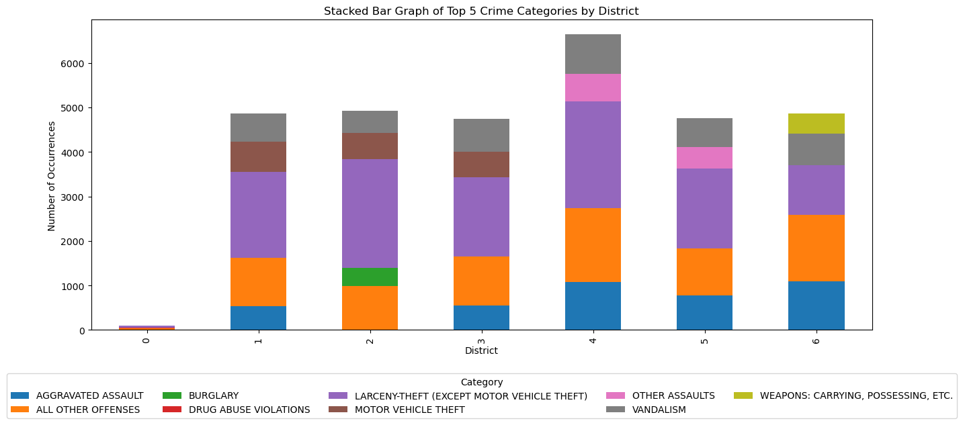
Where Crime Occurs
Question #6: What are the top crimes in each district?
4
5
2
1
3
Notes:
This stacked bar graph showcase the top five categories of crime per district. It is apparent that District 0 has nominal crime, raising a question about its population. The viewer can also see the tall purple sections in each district which represent the volume of Larceny. A final interesting observation is that District 6 is the only district where Weapons charges are in the top 5 crime categories and District 2 is the only district with Burglary charges in the top 5 crime categories.

Slide 11
Reporting Time
Question #7: What is the delay between when a crime occurs and when it is reported?
Metric | Length of Time
Average Reporting Time | 0.5 months
Shortest Reporting Time | 0 months
Longest Reporting Time | 658 months
Notes:
We will now review the delay time between when a crime occurs and when it is reported. This chart shows the average, shortest, and longest reporting times in the dataframe. I anticipated that most of these lag times would be close to 0 indicating that the crime was reported in the same month that it occurred. So I’m not surprised by the average and shortest reporting times, but the longest reporting time is concerning. I reviewed the entry with a 658 month reporting time and found that this was a “Sex Offense.” I’m not sure if this is a norm for this crime category, so on the next slide I next found the average reporting times per category.

Slide 12
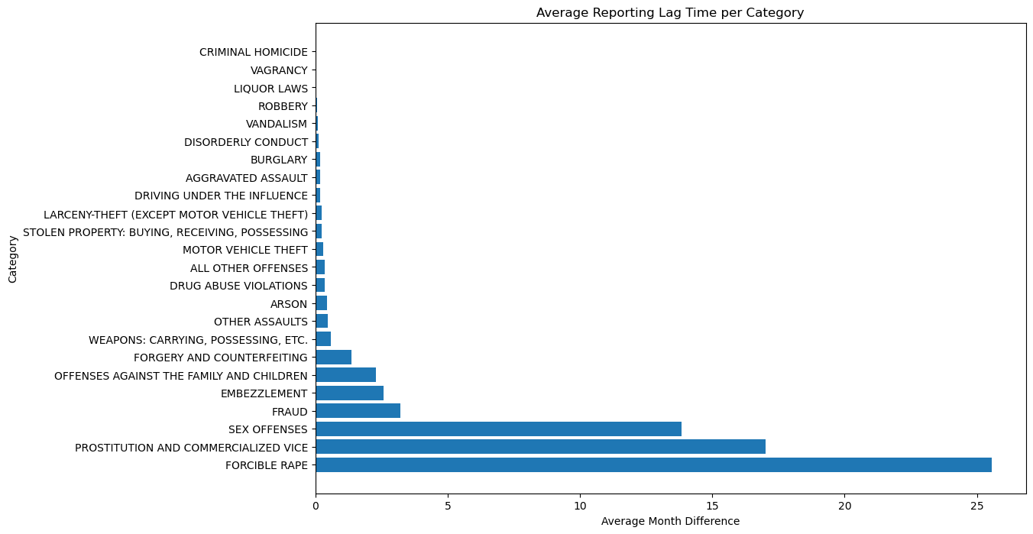
Reporting Time
Question #:8 How is the reporting delay dispersed among the different categories of crime?
4
5
2
1
3
Notes:
The three categories with the longest reporting lag time are all some form of sexual offense including the category that we found above which had the 658 month reporting time. Because the reporting delay in the top 3 categories so much greater than the remaining categories, I want to review the distribution of the reporting time between these categories.

Slide 13
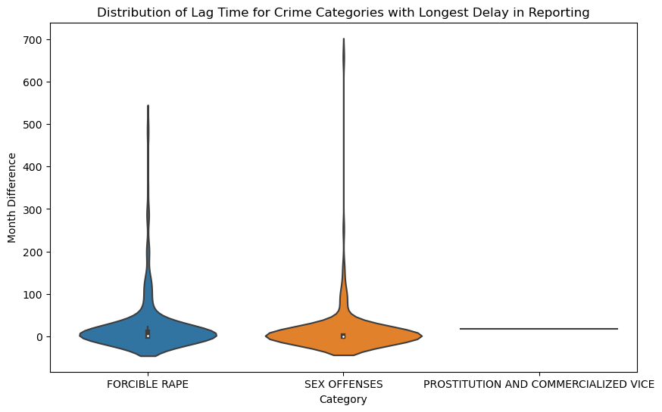
Reporting Time
Question #:9 Why are the top three average lag times so much greater than the reporting lag time of other categories?
4
5
2
1
3
Notes:
I made violin plots of the three crimes with the longest lag time to determine the distribution of this data and if there are outliers causing the data to skew towards a longer lag time. The item that stands out the most is the flat line for Prostitution and Commercialized Vice. I investigated this further and learned there were only two incidents of this crime in the dataset and those incidents had a large lag time. A generalization on the reporting time for Prostitution and Commercialized Vice would require additional data. Both Forcible Rape and Sex Offenses have outliers on the high end of the reporting lag time (such as the 658 month reporting time found in Question 8), but the bulk of the reporting times seem to range from 0-50 months and tapering off as the reporting time approaches 100 months. Overall, the large reporting times for these categories are due to either not enough data or outliers. But even without the outliers, the average reporting time is greater than the 4 month reporting time of the crime with the next highest reporting time.

Slide 14
Predictions
Question #10: Can future volumes of crime be predicted?
Metric | Result
Holt-Winters RMSE | 14.74 crimes per day
Average Crime in Dataframe | 117.92 crimes per day
Percent Accuracy | 79.54%
4
5
2
1
3
Date | Predicted City Wide Daily Crimes
2/23/21 | 96.65
2/24/21 | 91.89
2/25/21 | 85.28
2/26/21 | 92.17
2/27/21 | 94.66
2/28/21 | 85.00
3/1/21 | 98.06
Notes:
I used the Holt-Winters predictive model to predict future crime rates using parameters indicating seasonality and daily lag. I achieved an RMSE of 14.74 which indicates that on average the predicted volume of crime will be off by roughly 15 crimes per day. The dataset has a daily mean of 117.92. Therefore, on average the predictions will be about 80% accurate.

Slide 15
Findings/Recommendations
Topic | Finding | Recommendation
When Crime Occurs | Summer and Evening | Increase staffing and patrols during this time
Where Crime Occurs | Larceny is predominant city wide, District 4 has the highest vol of crime | Make Larceny prevention focus and education the public
Delay in Reporting | Sex Crimes have the longest delay | Provide a variety of platforms to report sex crimes
Predictions | On average, predictions will be accurate within 14.74 daily crimes | Use to allocate resources and provide a benchmark
Notes:
Predictions – Provide a benchmark to see if mitigating efforts were effective.
Caution: It is ideal if valuables are locked in a safe, but if valuables are not secured and someone is robbed the victim is not responsible for the robbery.
Caution: The largest ethical concern I have with this study is that I do not want to “victim blame.” It is ideal if a crime is reported immediately so evidence is more readily available. However, if a victim is not comfortable coming forward until months or years later, it is important that the victim is not shamed. This will likely result in future victims opting to not report at all, which would be more detrimental than a delay in reporting.

Slide 16
Implementation
Meetings with police department and city officials
Prioritize recommendations
Engage community/Public education
Rerun study at future date
Notes:
To determine how they want to apply the findings and recommendations in this study.

Slide 17
Resources
Federal Bureau of Investigation. (2004). Uniform Crime Reporting Handbook. https://ucr.fbi.gov/additional-ucr-publications/ucr_handbook.pdf
Police Executive Research Forum. (2022, March). PERF Survey Shows Steady Staffing Decrease Over the Past Two Years. https://www.policeforum.org/workforcemarch2022
Schneider, J. (2023, November 25). New crime ranking lists St. Louis as third “most dangerous” US city. FOX 2. https://fox2now.com/news/missouri/new-crime-ranking-lists-st-louis-as-third-most-dangerous-us-city/
St. Louis Metropolitan Police Department. (2008). Crime Data Frequently Asked Questions. https://www.slmpd.org/Crime/CrimeDataFrequentlyAskedQuestions.pdf
St. Louis Metropolitan Police Department. (2021). SLMPD Downloadable Crime Files. https://www.slmpd.org/Crimereports.shtml

Slide 18
THANK YOU !

